Slide 1
Telegenetics in North Carolina
Chad Haldeman-Englert, MD
Fullerton Genetics Center

Slide 2
Telemedicine in NC
Discussed at a recent North Carolina Medical Genetics Association (NCMGA) meeting
Updating a state genetics/genomics plan through the NC Department of Health and Human Services
Understand the landscape of telegenetic services
‘State of the State’

Slide 3
Telegenetics in NC
Survey
30 questions – individualized responses
Sent to the NCMGA membership (twice)
Open for 1 month
Definitions
Genetic and genomic services: genetic counseling (cancer, prenatal, etc), pediatric/adult genetic evaluations (involving an examination), nutrition counseling for metabolic conditions, other
Telegenetics: genetic and genomic services provided remotely using videoconferencing

Slide 4
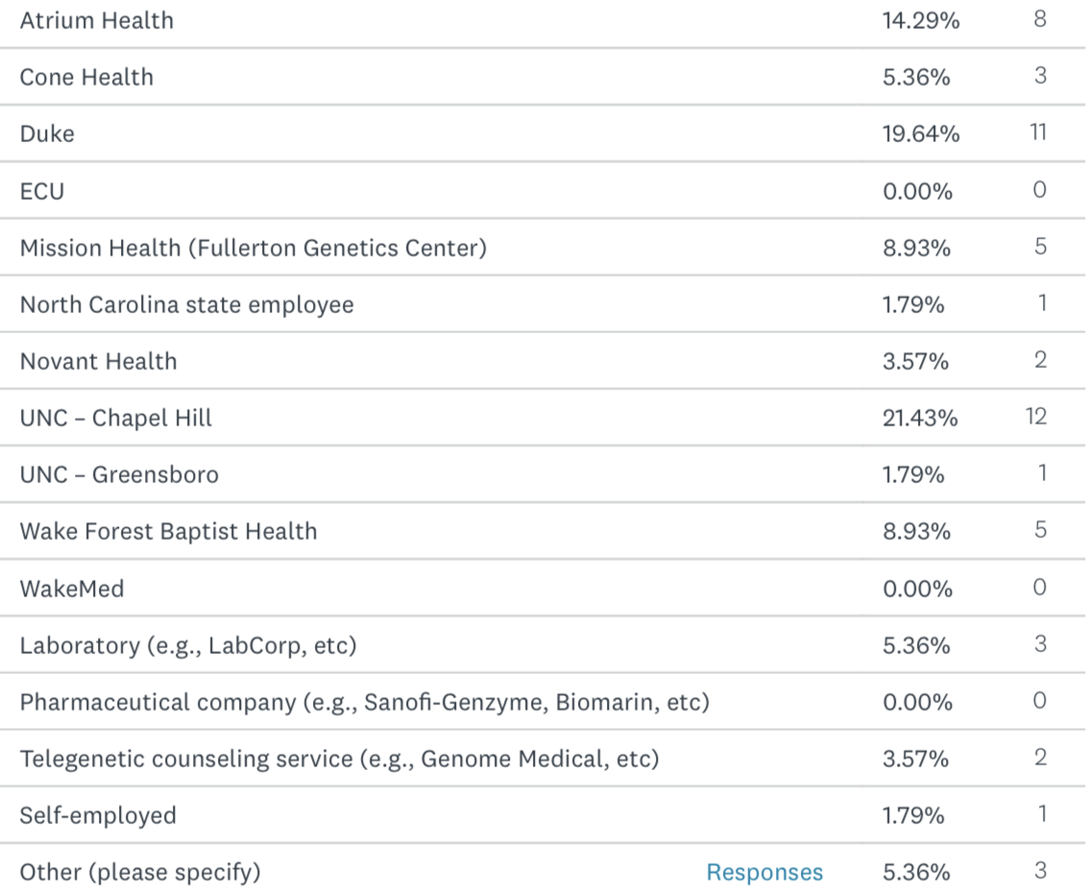
Responses
56 total responses
48 genetic counselors
1 also a registry director for a nonprofit
7 geneticists
1 maternal fetal medicine physician
20 provide telegenetics services (36%)

Slide 5
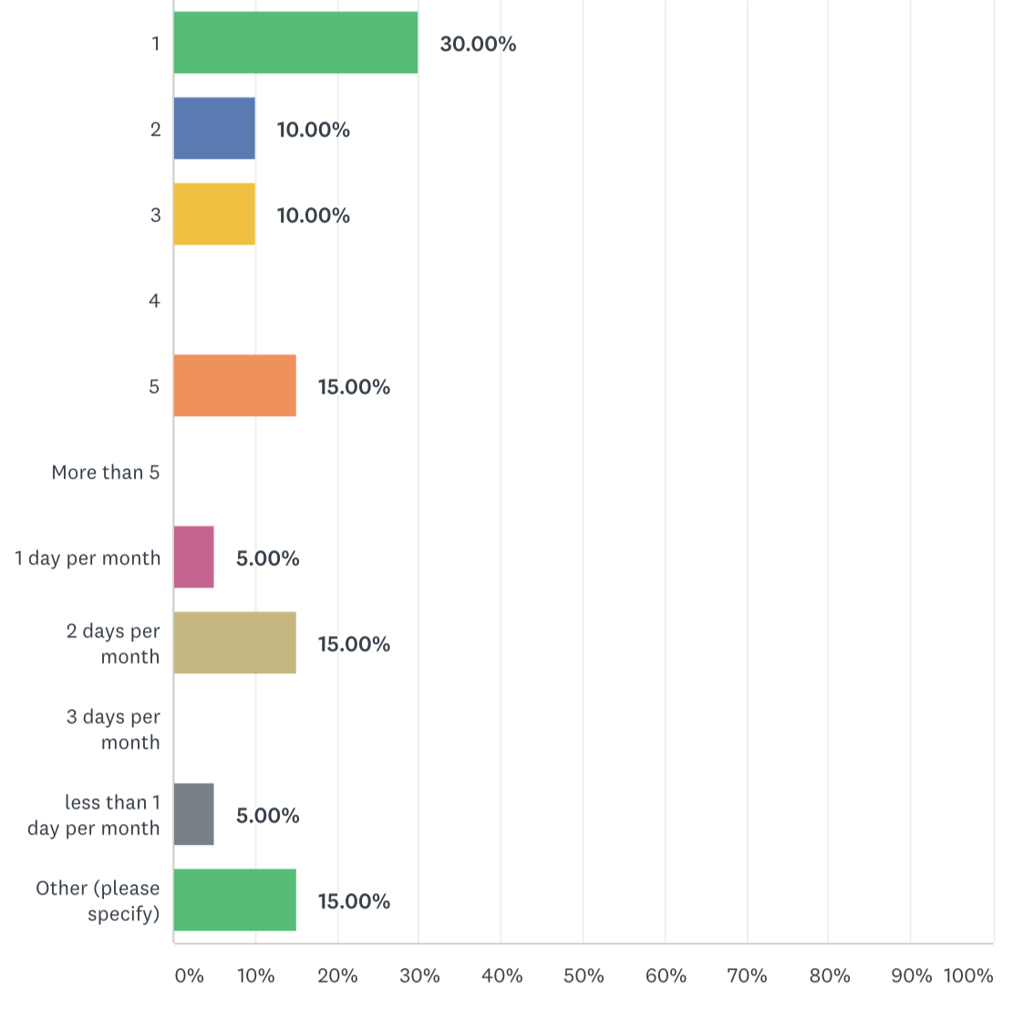
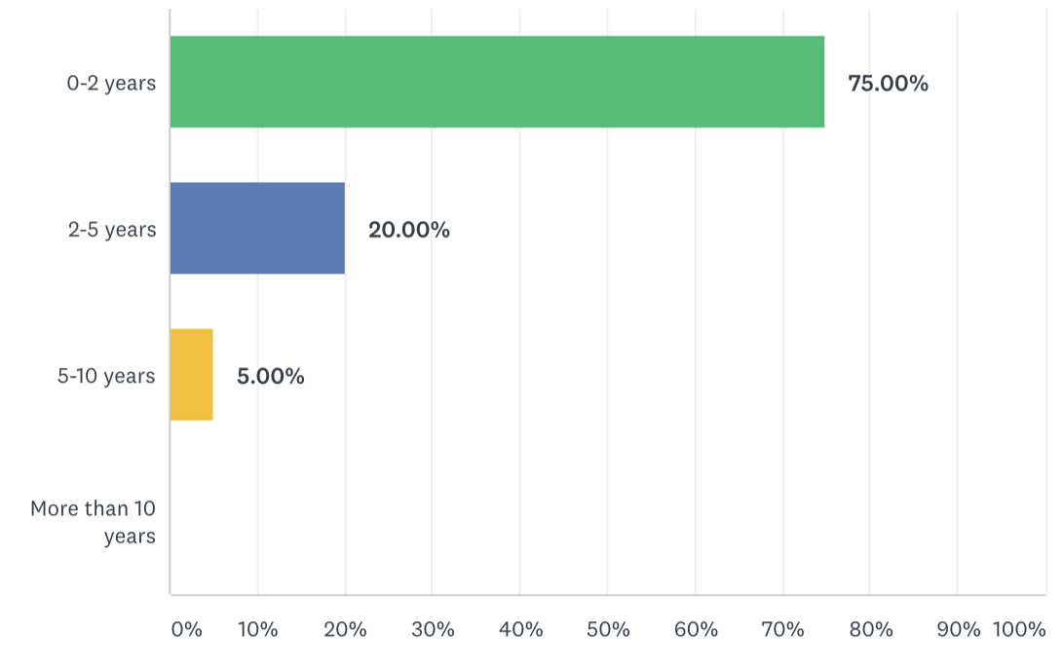
Services performed
Days
per
week

Slide 6
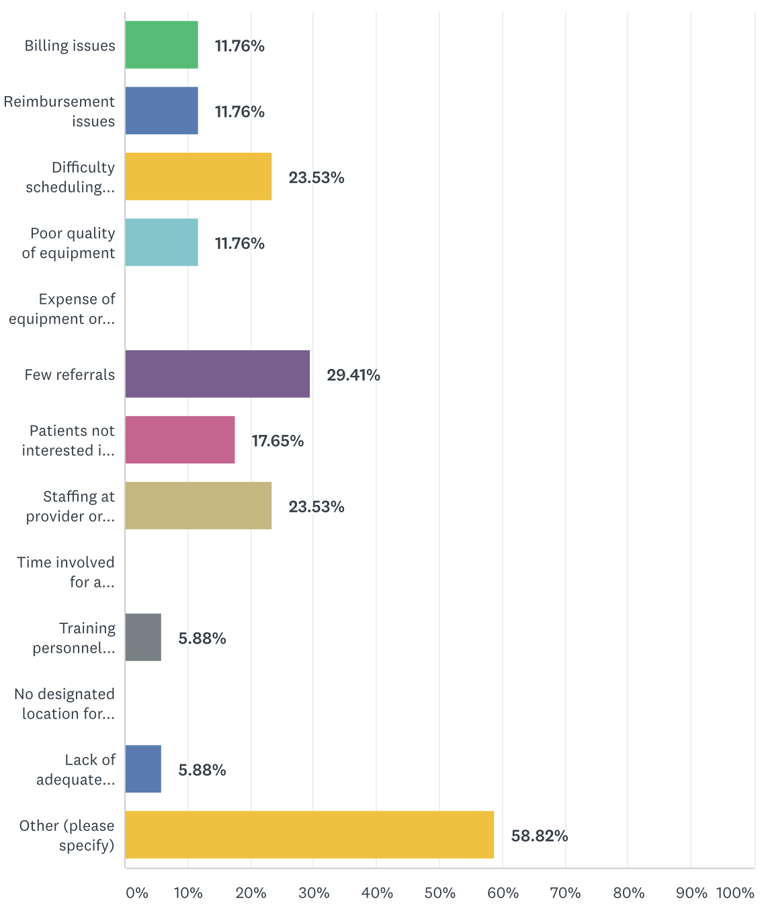
Initial barriers/current issues
Comments
Nursing staff rooming patients so limited times available
Obtaining results from ordered testing
Lack of GC licensure

Slide 7
Support

Slide 8
Software
InTouch – Fullerton
Vidyo – Atrium
VSee – telegenetic company
Webex – Duke, UNC, Wake Forest
Zoom – Novant, telegenetic company
Employer specific platforms – lab, telegenetic company

Slide 9
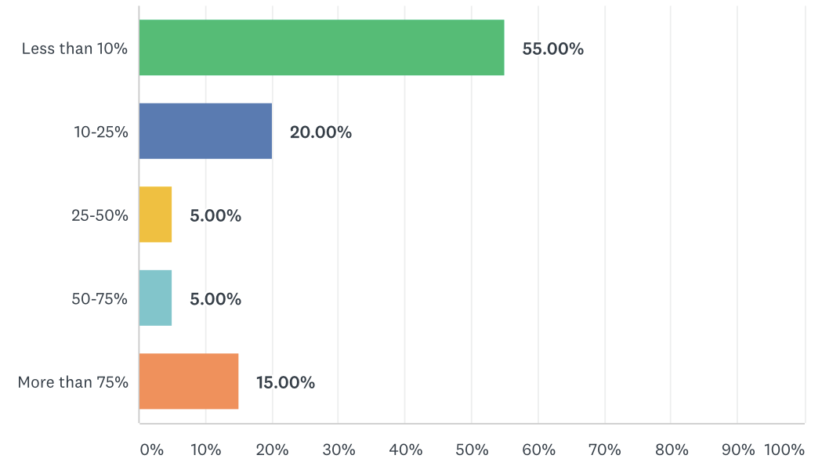
Volumes
How many patients within the last year
Percentage of visits involving telegenetics

Slide 10
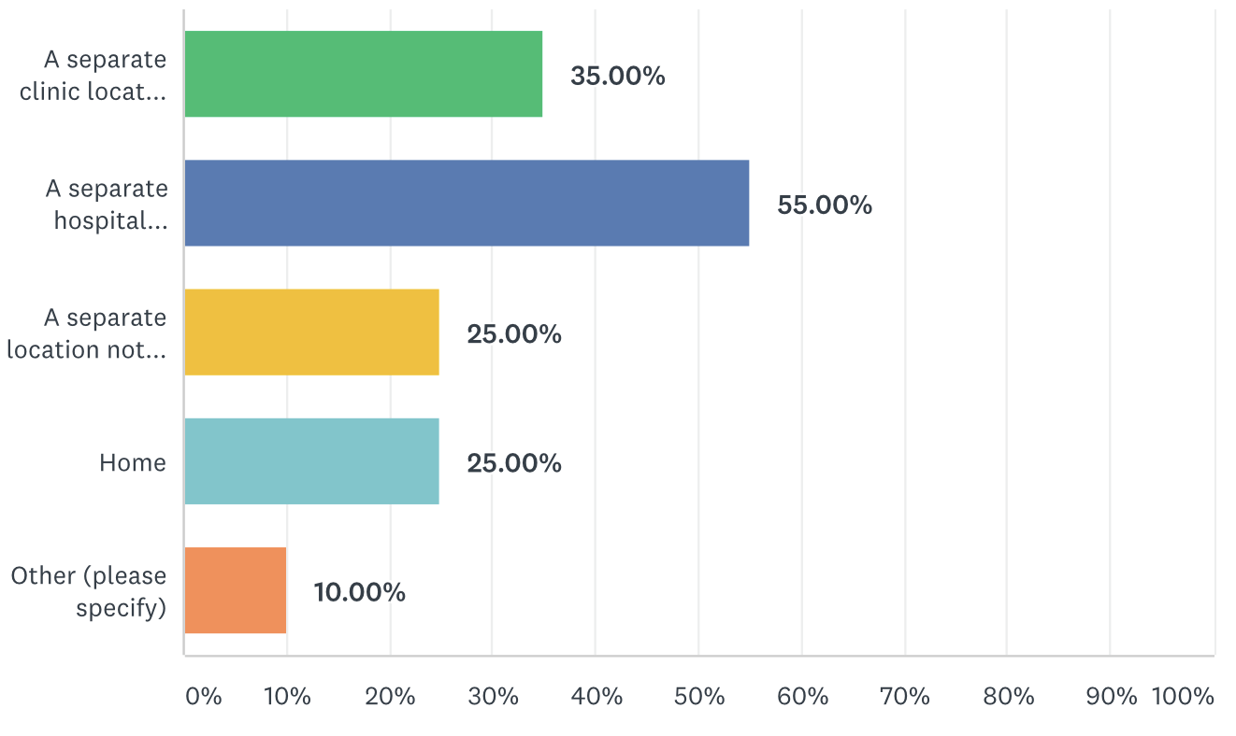
Patient demographics
Percentage of patients are from North Carolina
Location of patients

Slide 11
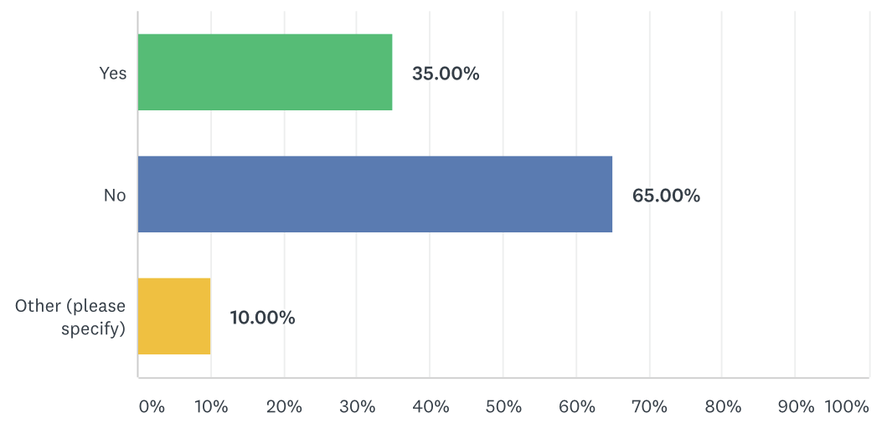
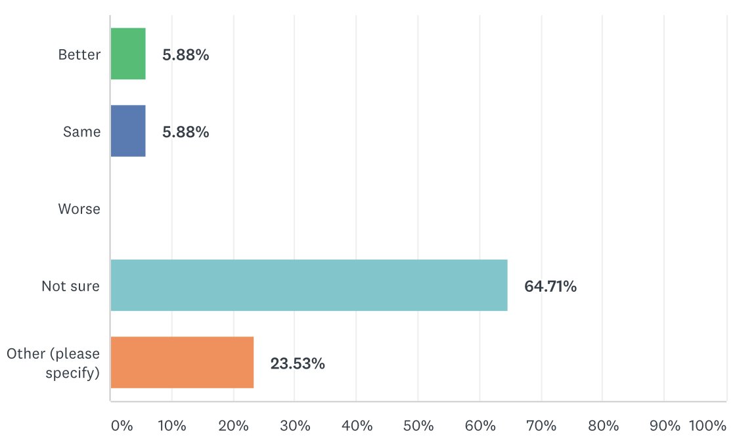
Billing/reimbursement
Percent that bill
Percent that are reimbursed
How reimbursement compares to in-office visit

Slide 12
Those who don’t currently do telegenetics
Of those who are currently not doing telegenetics, 83% do not plan to begin this service
Comments
All of the above
Provide support through phone and email so no need to add video
Too many patients
Others are doing it here
No interest by employer
Not part of job

Slide 13
Training for telegenetics
Intensive training not required
Would benefit from online and on-site training
Should be part of student/resident rotations
Similarities/differences
Different strategies vs in-person visit
Visual aids
Eye contact
Quality improvement project
Should also include billing issues
Need more training of staff

Slide 14
Future use in NC
No sure if needed given the genetics groups across the state
Need a better understanding of the use of telegenetics before using more
Need to know how many more patients would access
Consider using local health departments
State/institutions work together
Better billing/reimbursement that may improve with GC licensure

Slide 15
Additional comments
Better use of resources to help with transportation and overnight stays instead of telemedicine due to similar no-show rates
Needs to be easier for patients (e.g., home)
Better for certain situations (cancer, prenatal) vs others (metabolic clinic)

Slide 16
Future plans
North Carolina
Genetic/genomic advisory committee for DHHS
Increase patient access to genetic services
Includes telemedicine component

